Slide 1
Control Board to Turbo TC110 Cable

Slide 2
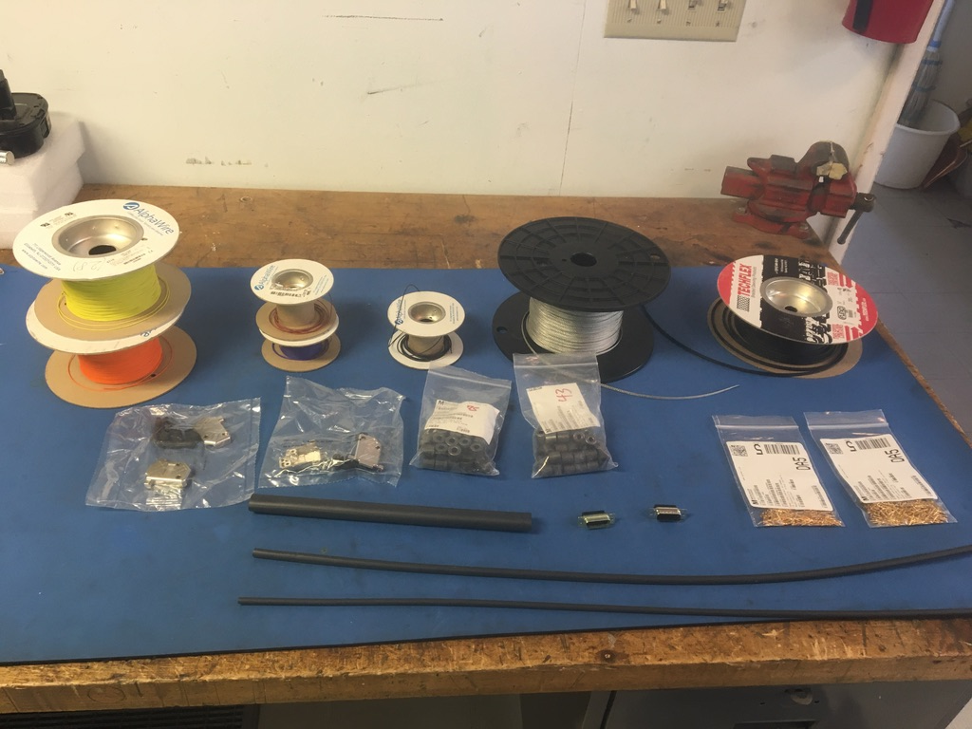
Materials

Slide 3
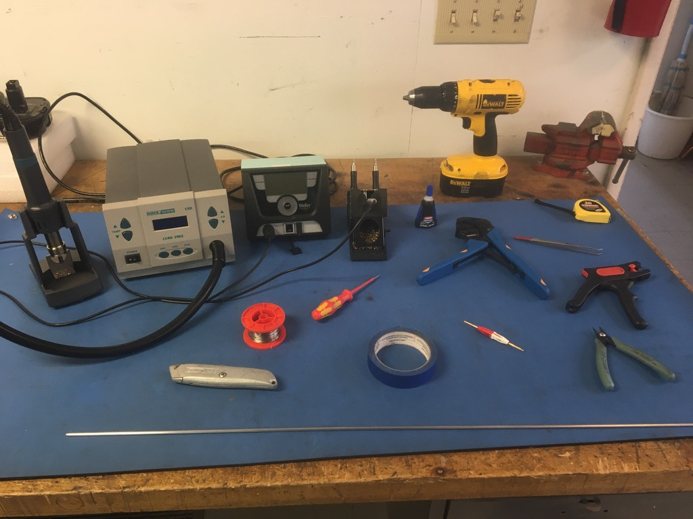
Tools

Slide 4
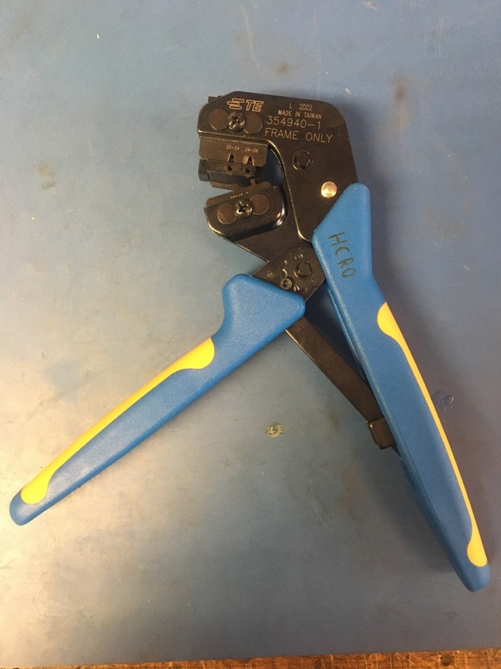
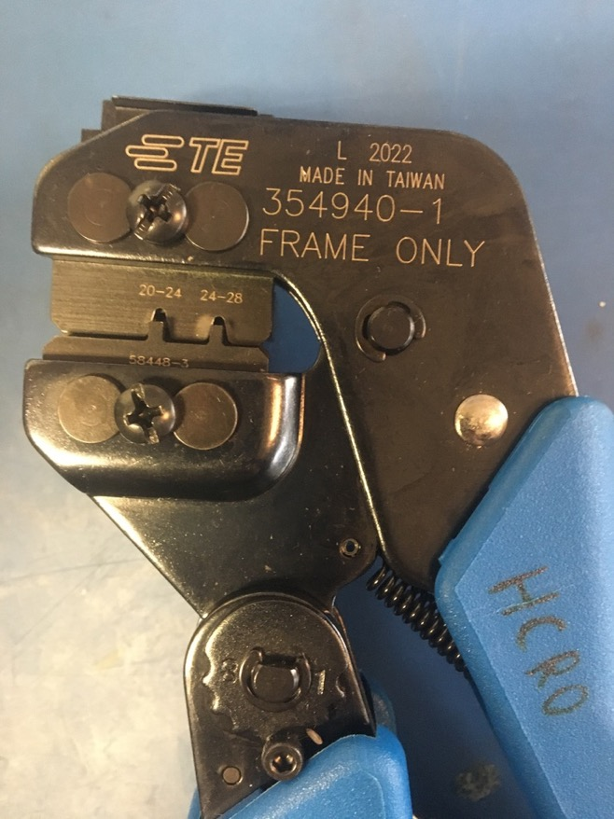
D Sub Crimp Tool

Slide 5
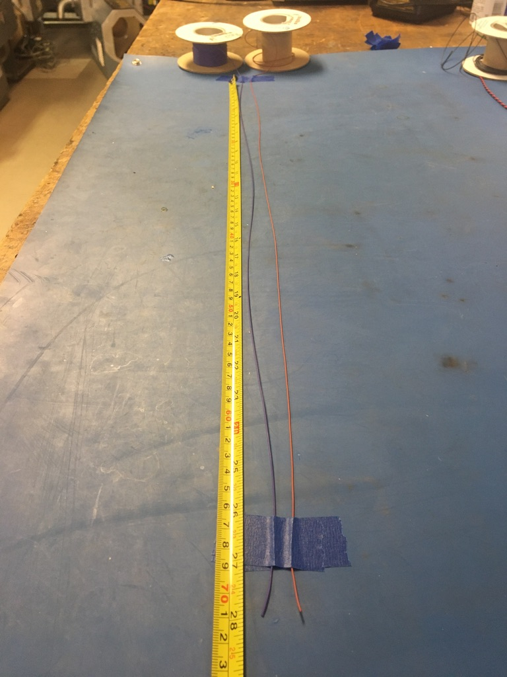
Measure out and cut 28 inches of brown, violet, yellow, and orange 28 awg wire as well as balck and red 20 awg wire.

Slide 6
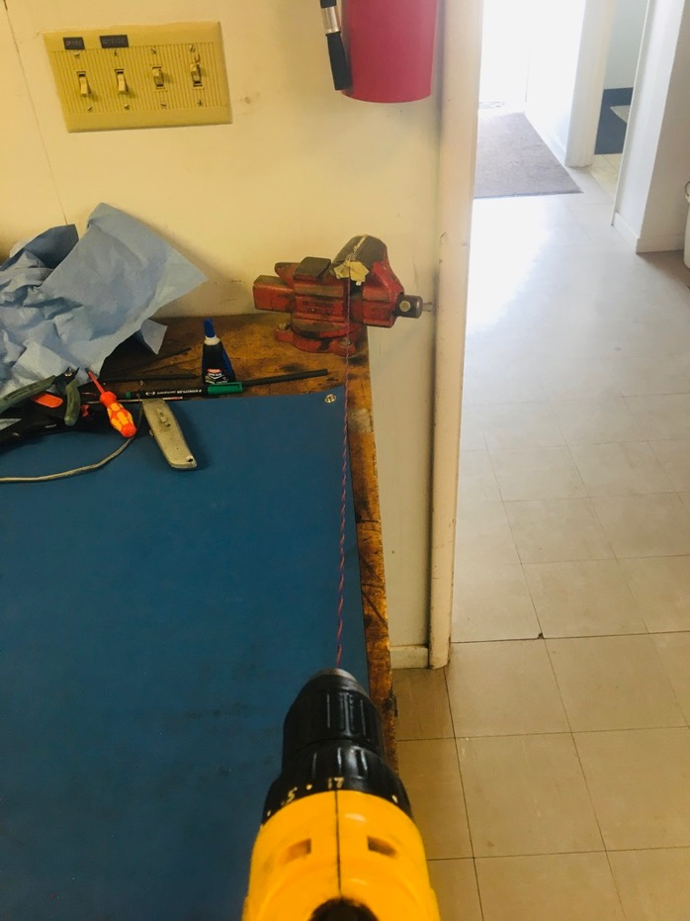
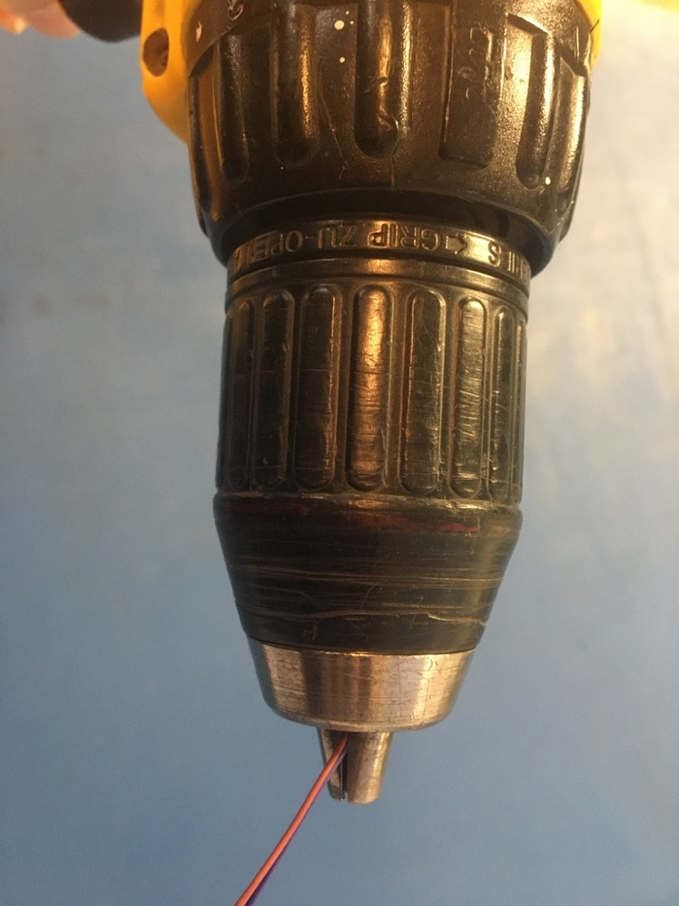
To make the twisted pairs, line the vise with masking tape. Put one end of the brown and violet wires into the drill. Run the drill till the wires are sufficiently twisted (for reference see the next slide). Repeat with the black, red, yellow, and orange wires to make a red/black twisted pair and a yellow/orange twisted pair.

Slide 7
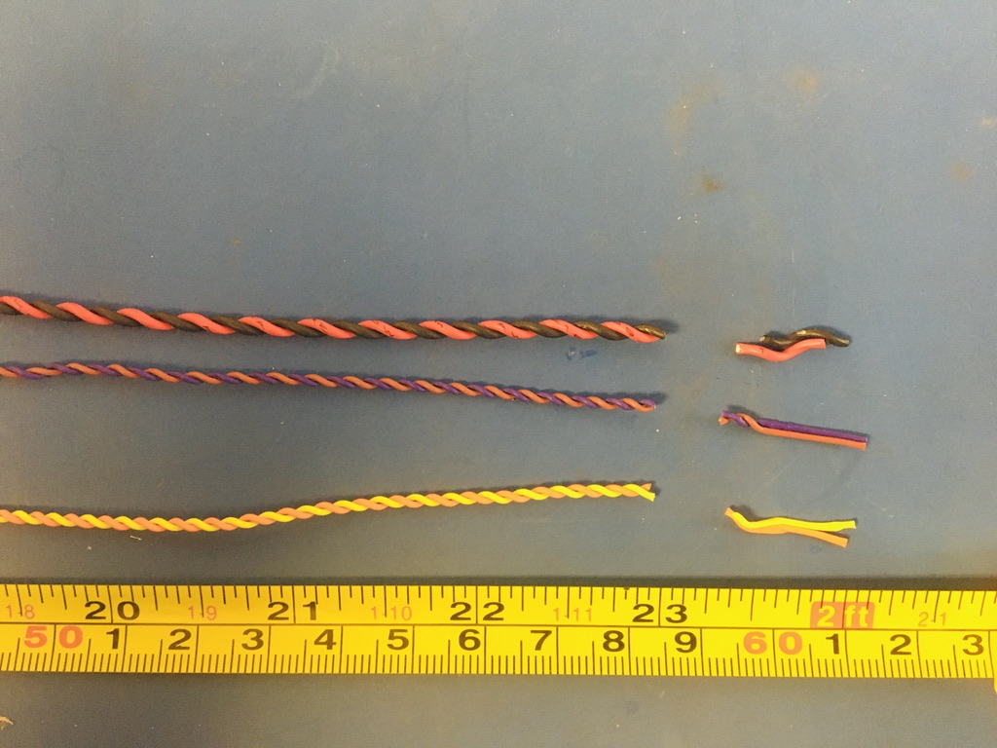
Trim the ends of each twisted pair where they were in the vise and drill. Once trimmed, they should measure about 23 inches.

Slide 8
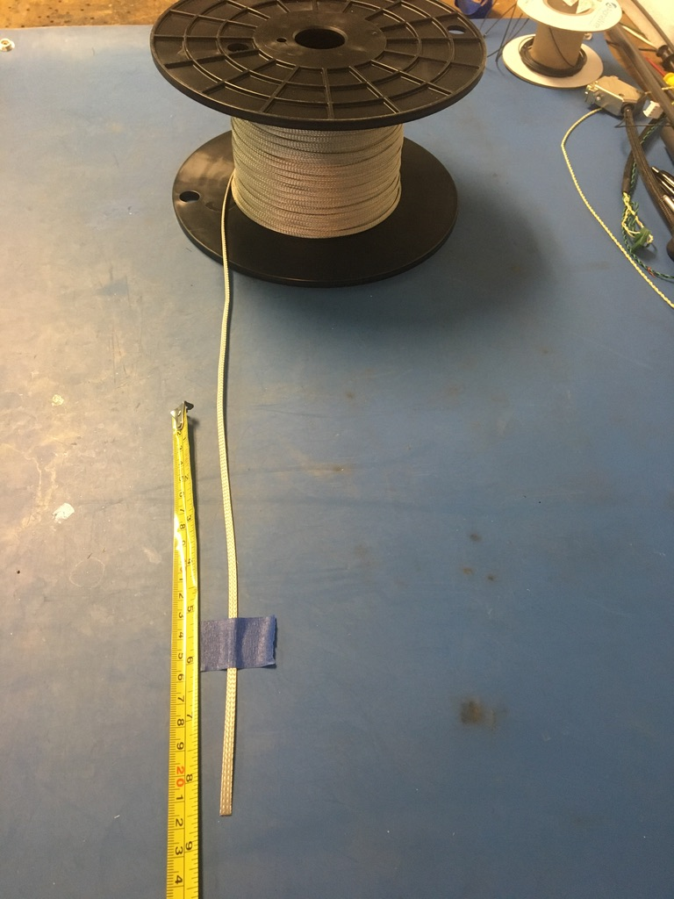
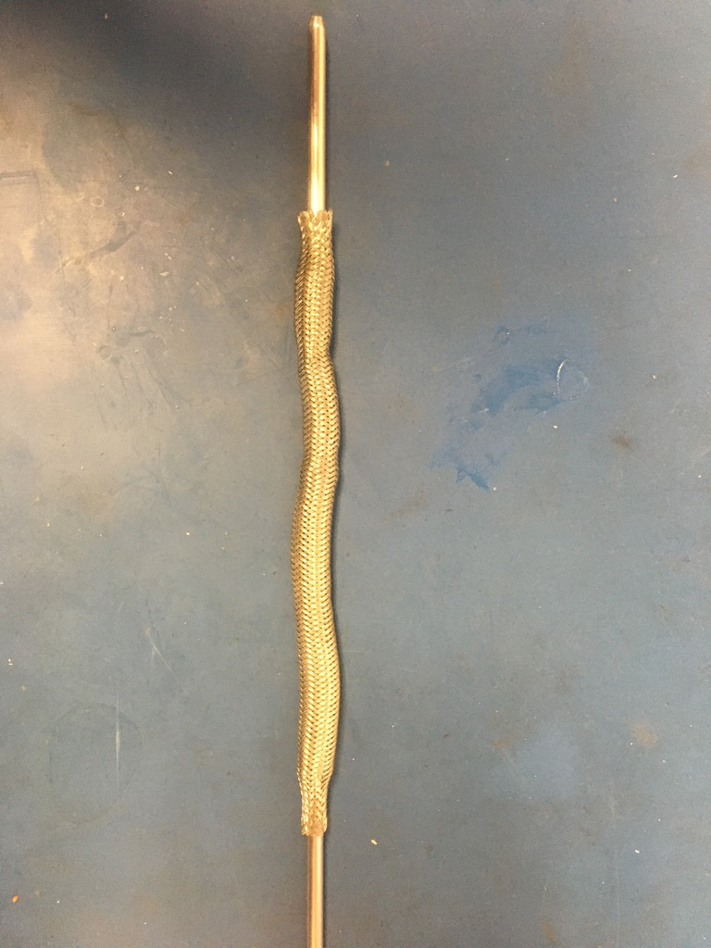
Measure out 8.5 inches of the 1/8th metal braid. Expand it using the metal rod.

Slide 9
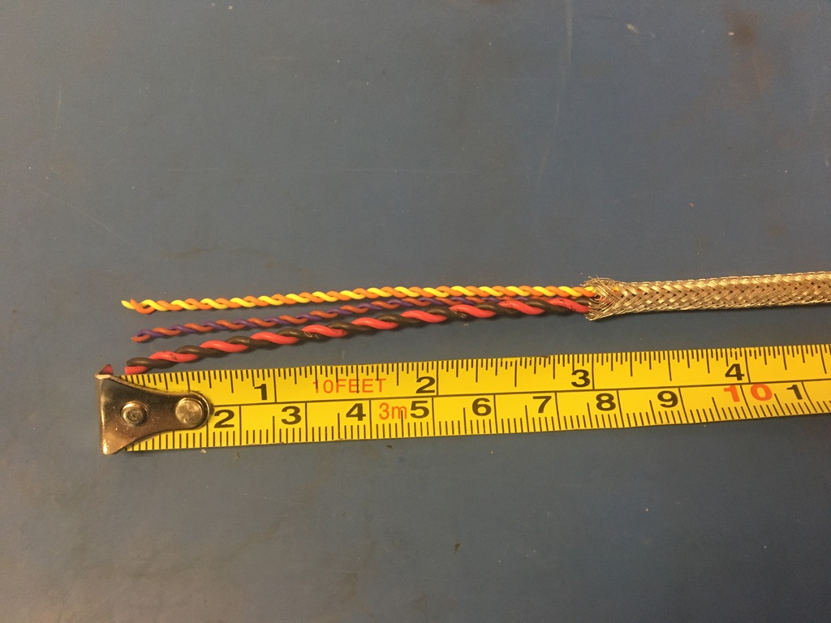
Put the twisted wires into the expanded metal braid. 3 inches of the twisted wires should stick out from the metal braid on one end.

Slide 10
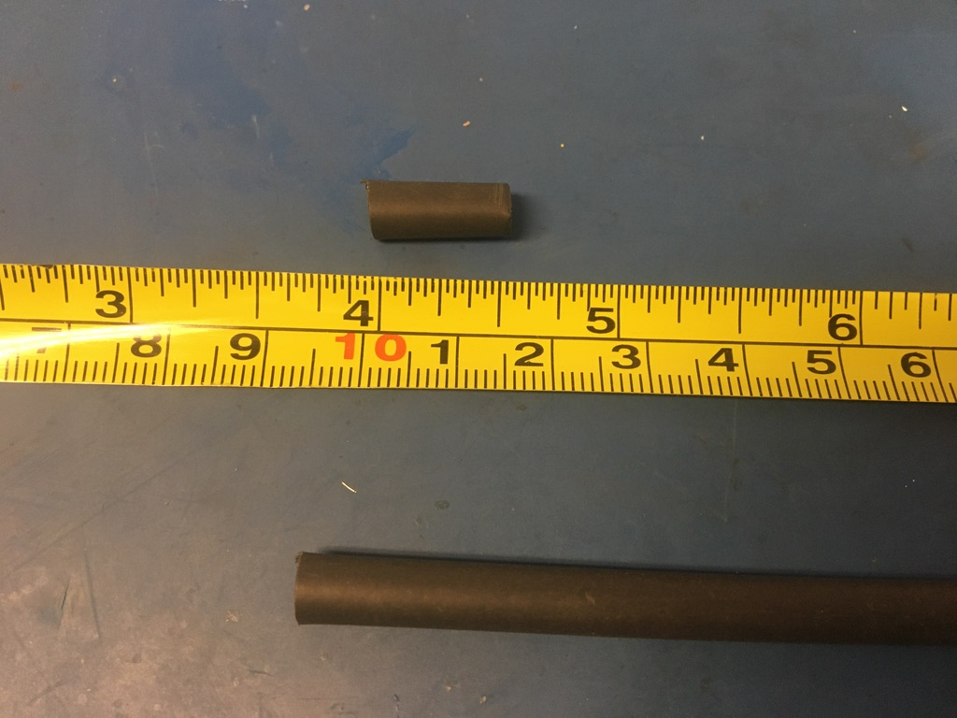
Measure out and cut two lengths of 4.8mm adhesive shrink tube each .5in long.

Slide 11
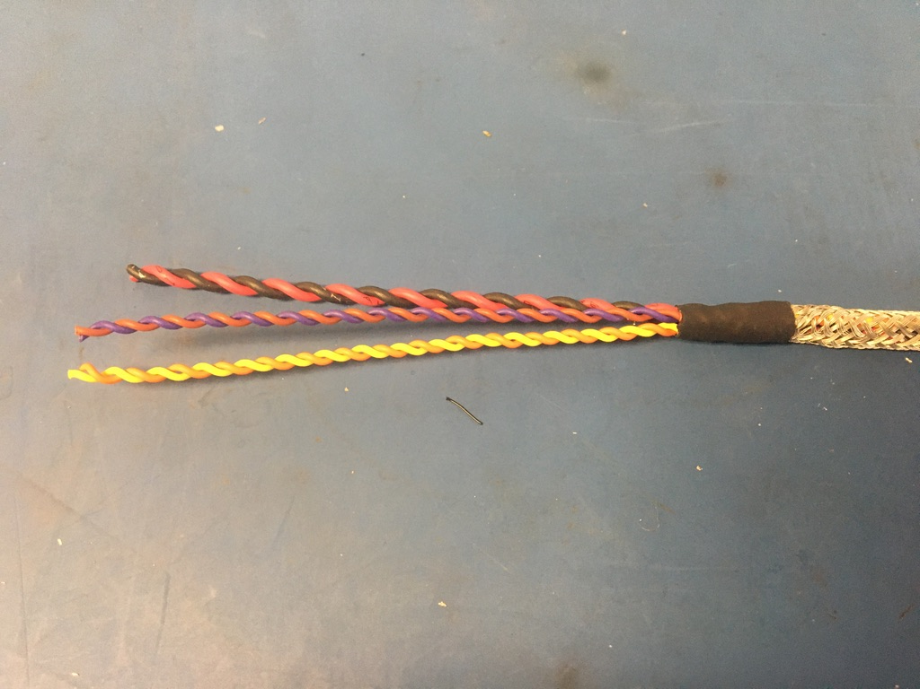
Put one of the pieces of the shrink tube onto the end of the metal braid where the wires measured 3 inches. Place the shrink tube such that the metal braid ends midway through it. The wires should now measure 2.75 inches long. Apply the heat gun to the shrink tube.

Slide 12
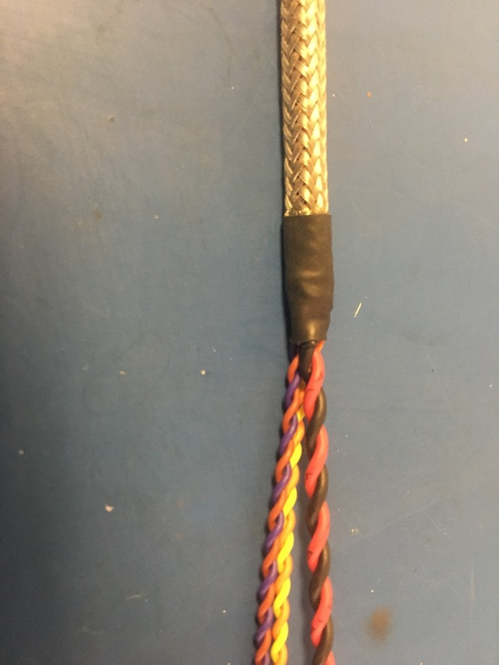
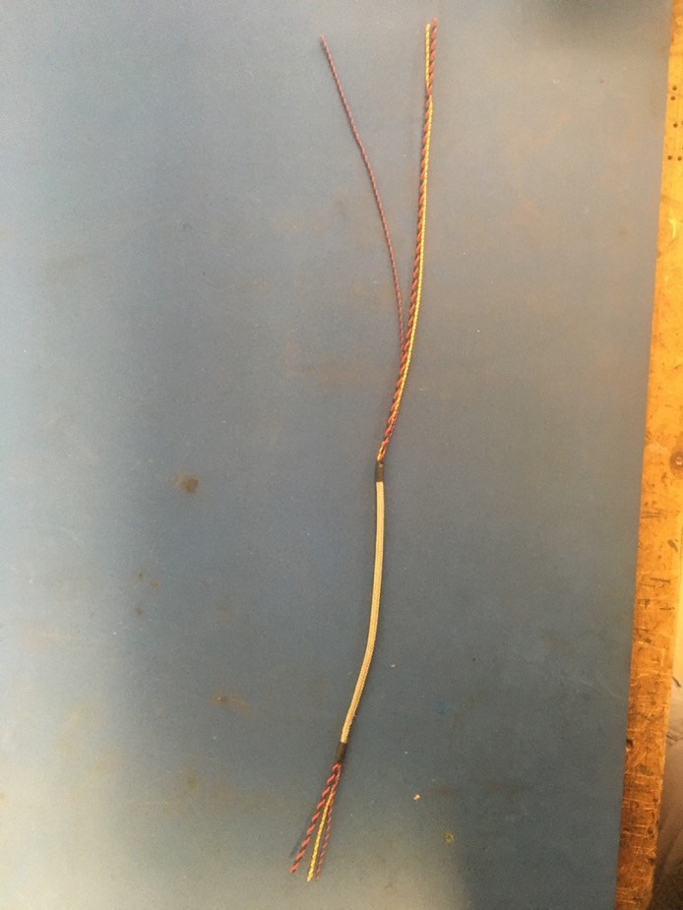
Repeat the process on the previous slide on the other end of the metal braid (though the wire does not need to be measured this time). Thus far, the wire harness should appear as shown on the right.

Slide 13
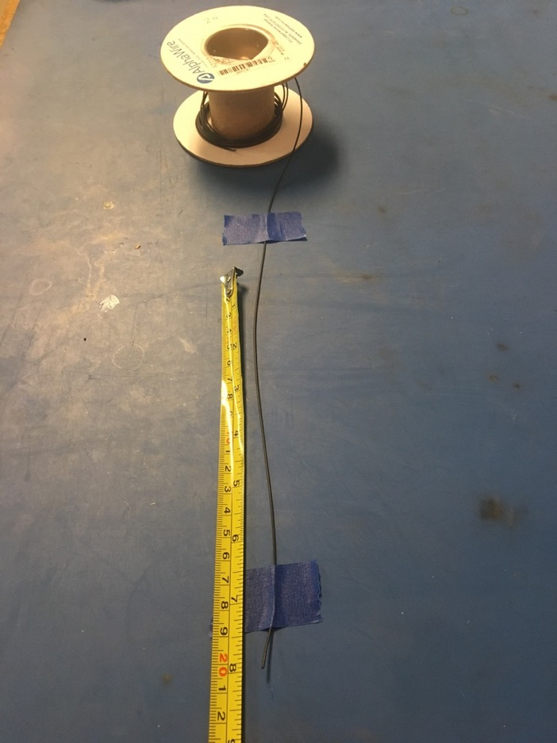
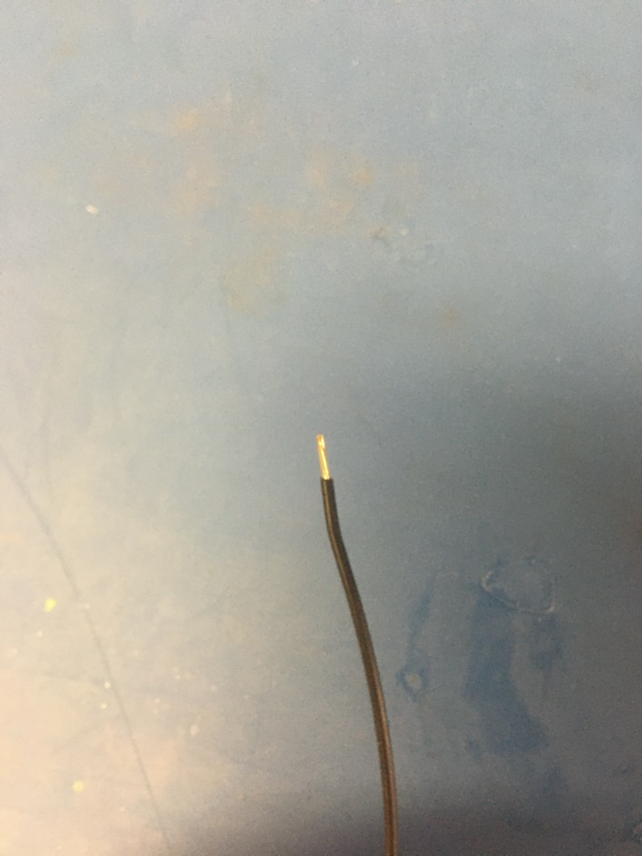
Measure out and cut 8.5 inches of black 24 awg wires. Strip 3-4mm off one end.

Slide 14
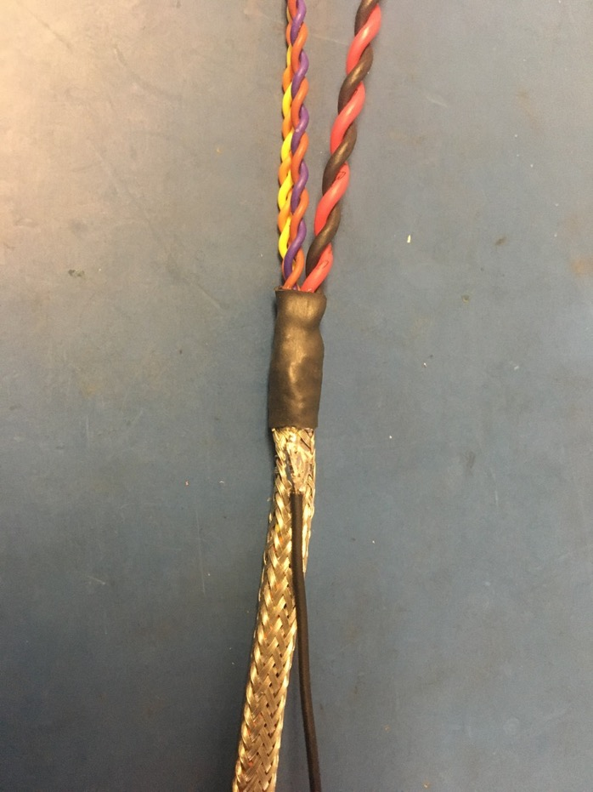
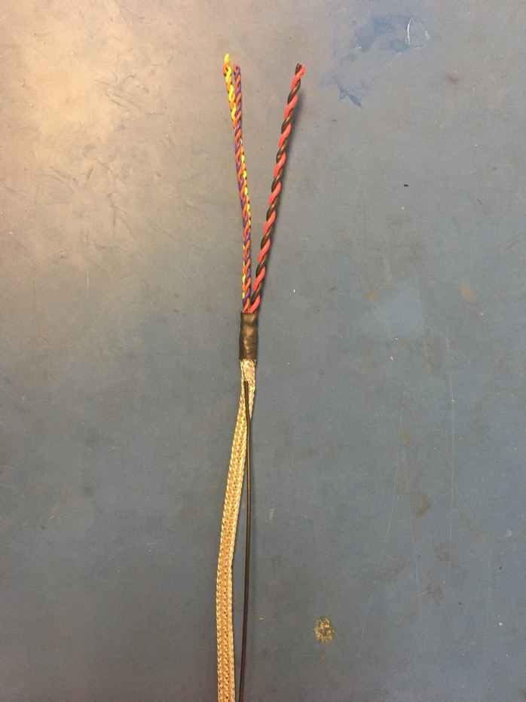
Solder the stripped end of the black wire onto the metal braid near the shrink tube joint with the shorter length of wire (the end that was measured to be 2.75 inches). The black wire should be soldered so the that its length runs with that of the metal braid.

Slide 15
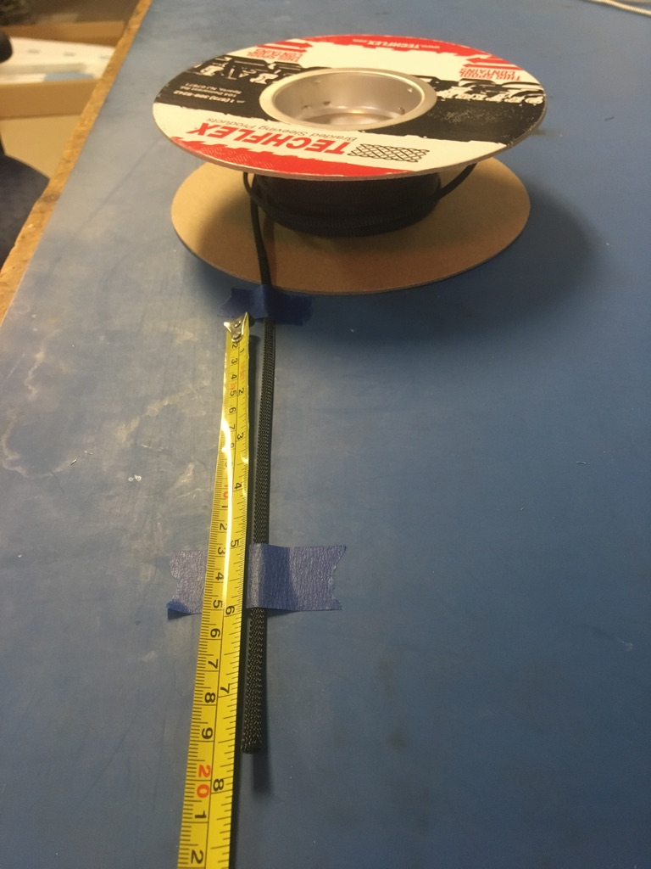
Measure out and cut 7.75 inches of 1/4th plastic braid.

Slide 16
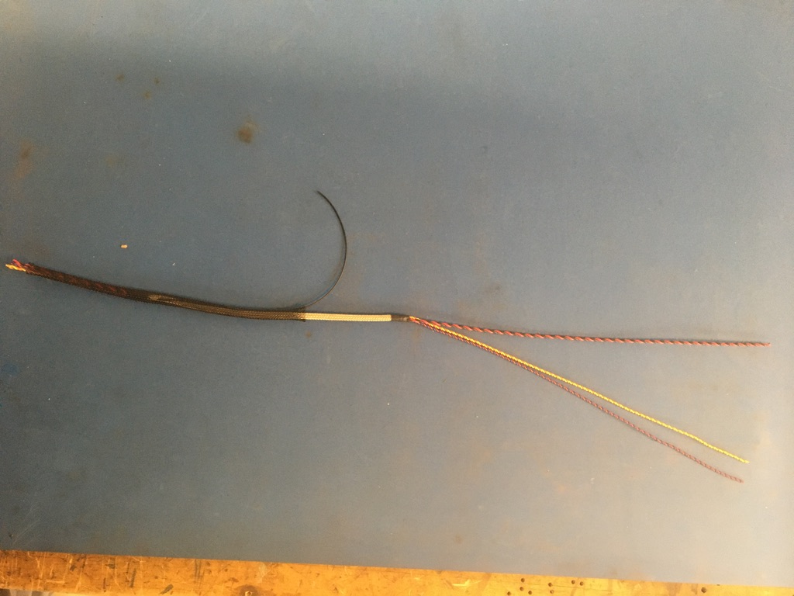
Put the plastic braid onto the wire harness. It does not matter from which end.

Slide 17
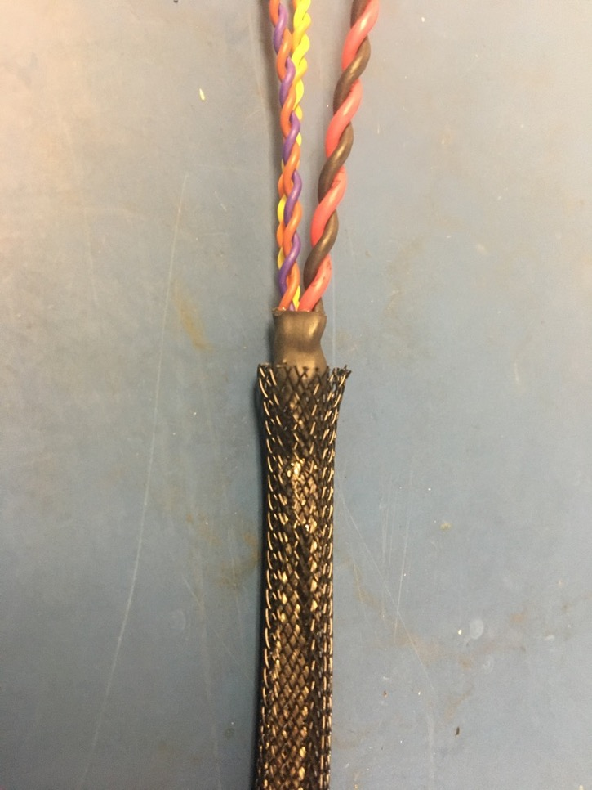
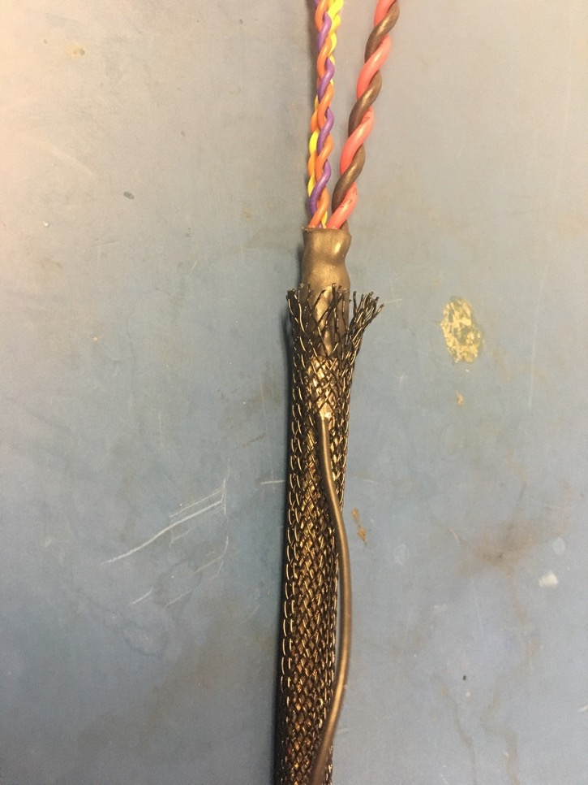
Thread the ground wire through one of the holes in the plastic braid so it appears as shown of the right. At each end of the harness, the plastic braid should end midway through the metal shrink tube joints.

Slide 18
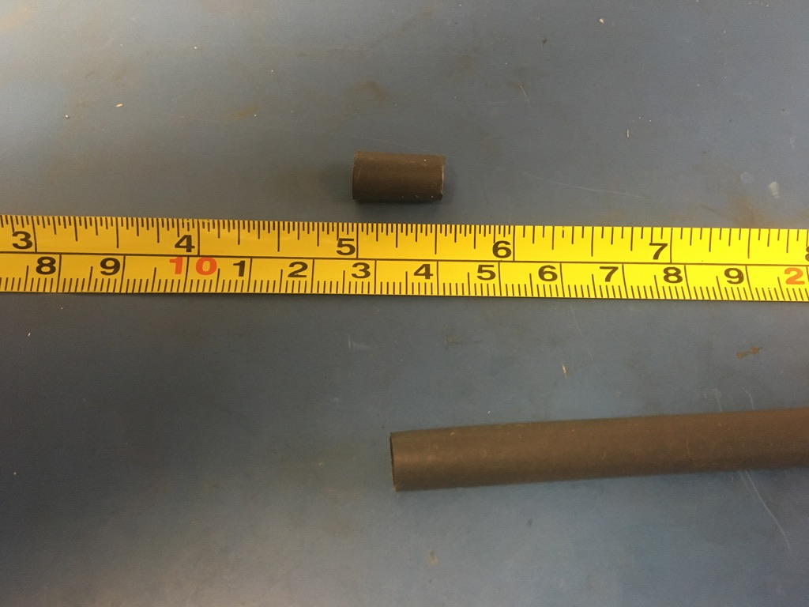
Measure out and cut one length of 6.4mm adhesive shrink tube that is .5in long.

Slide 19
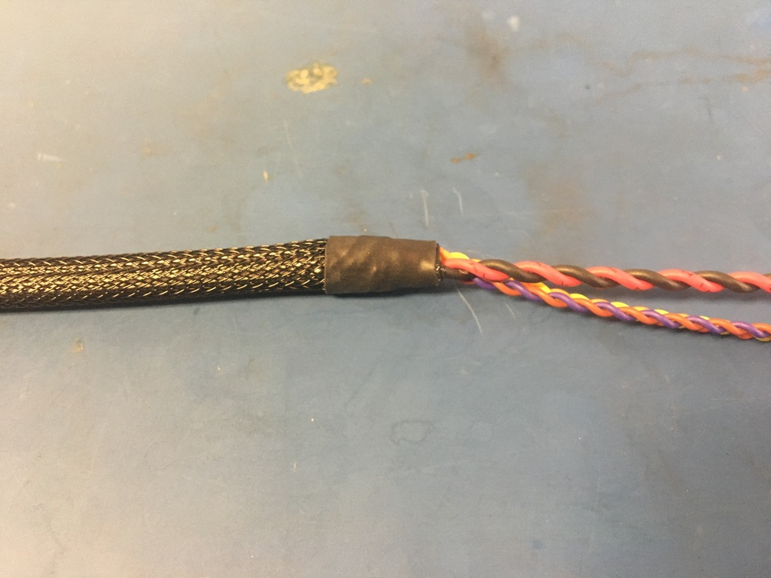
Place the piece of shrink tube onto the plastic braid end without the ground wire. The plastic braid should end midway through the piece of shrink tube. Apply the heat gun.

Slide 20
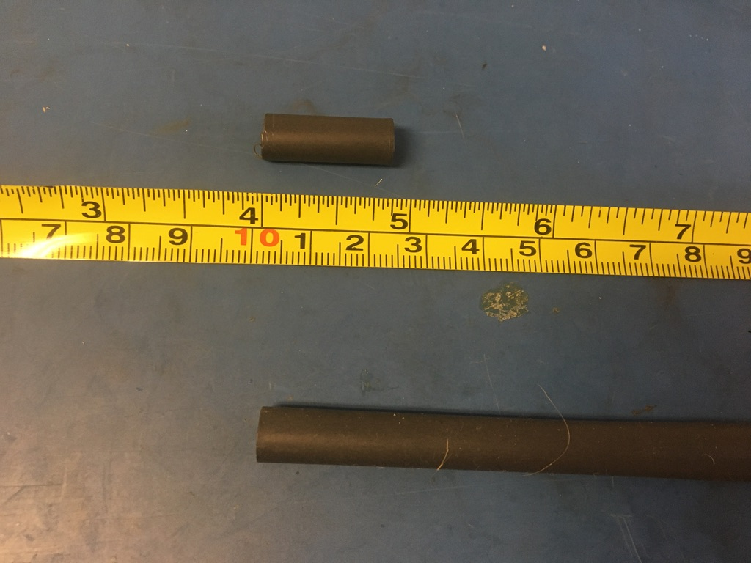
Measure out and cut one length of 6.4mm adhesive shrink tube that is 1in long.

Slide 21
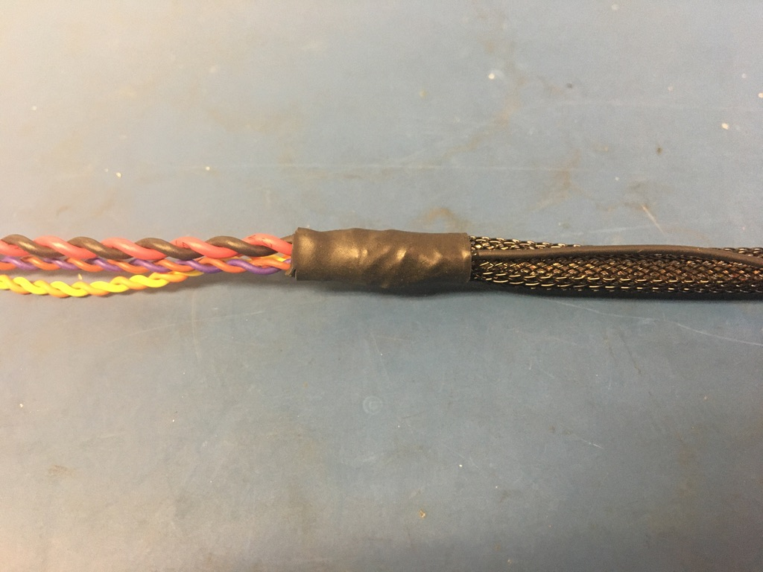
Place the piece of shrink tube onto the ground wire end of the harness. The shrink tube should be placed such that it covers the solder joint and the length of the metal braid shrink tube. Apply the heat gun.

Slide 22
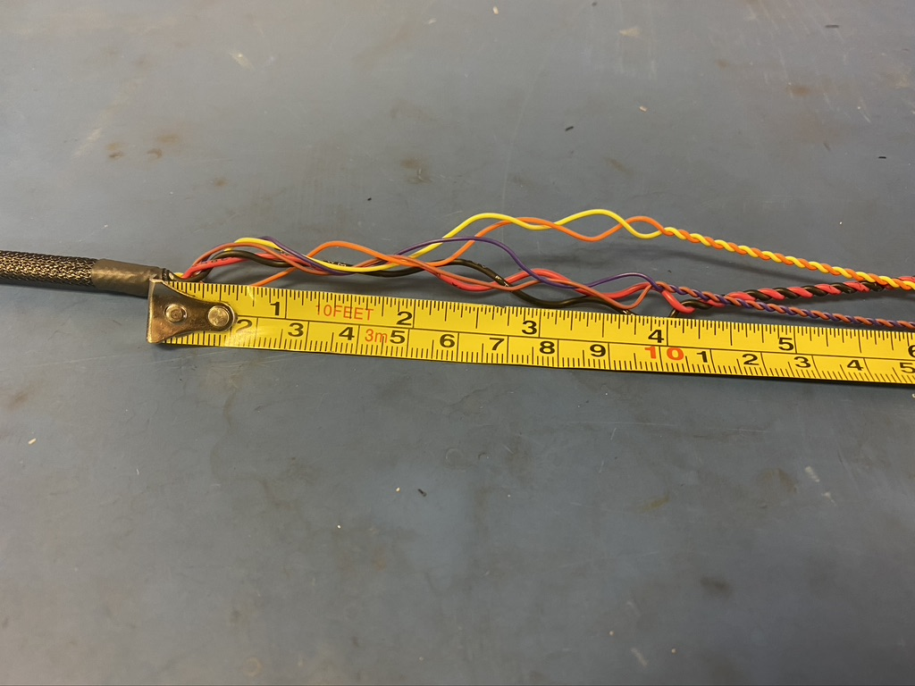
Take the end of the harness without the ground wire and untwist about 4in of the twisted pairs.

Slide 23
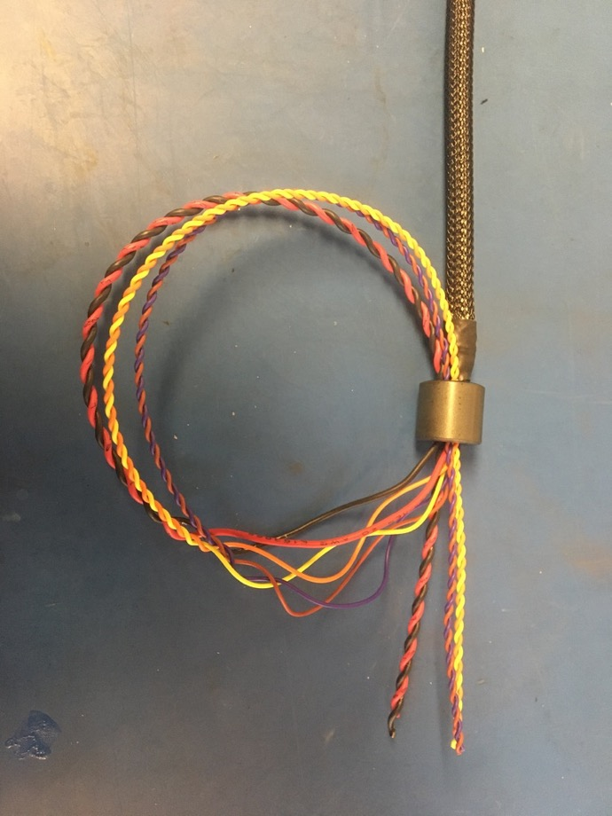
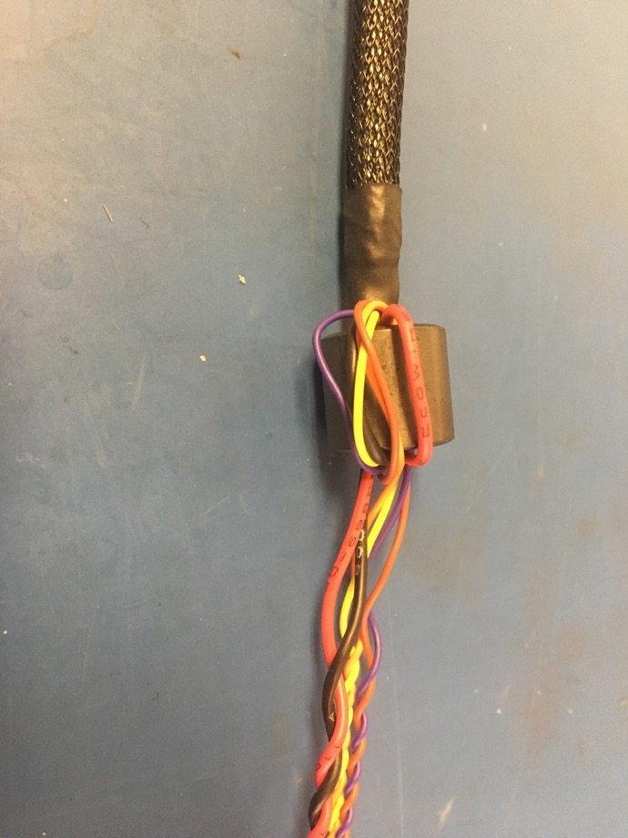
Thread the 75 magnet onto the end of the harness that was just untwisted. Then thread the wires back through the bottom of the magnet as shown on the left. Pull the loop of wire taught so the magnet appears as shown on the right.

Slide 24
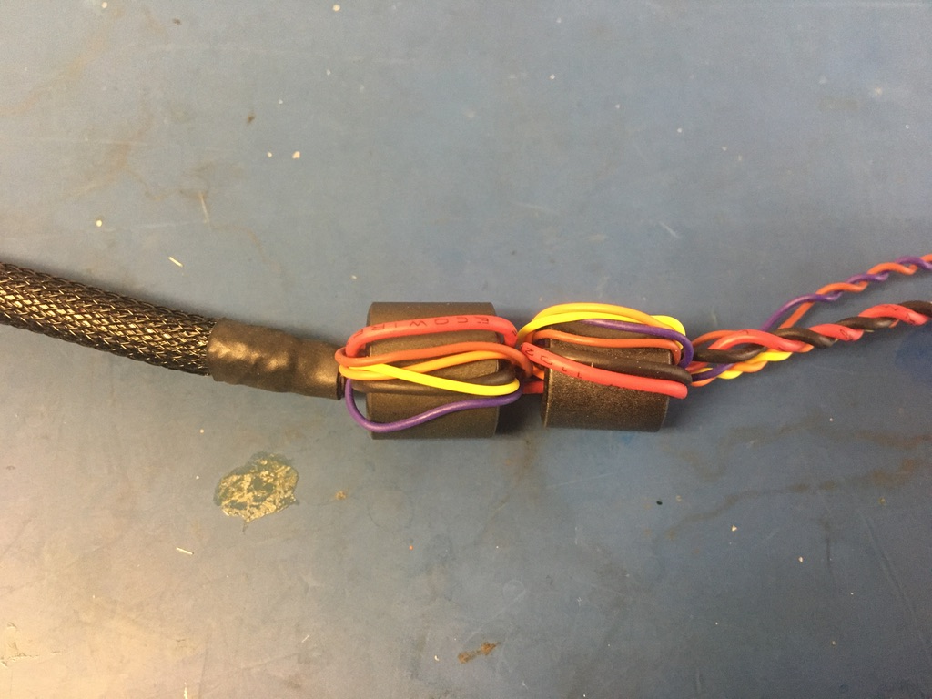
Repeat this process with the 43 magnet. It may be necessary to untwist more wire for the 43 magnet.

Slide 25
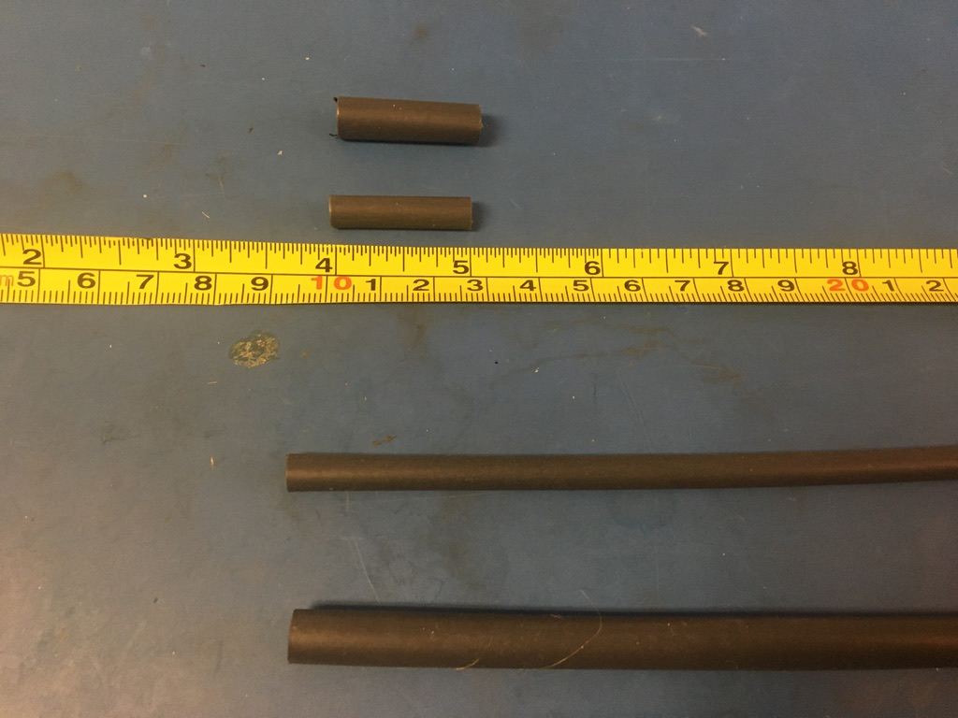
Measure out and cut 1in long lengths of 4.8mm and 6.4mm adhesive shrink tube.

Slide 26
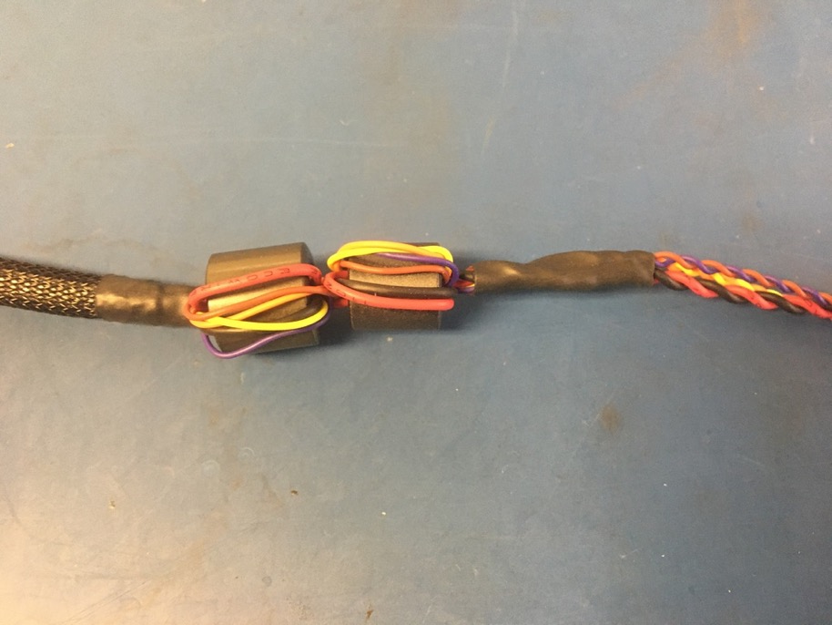
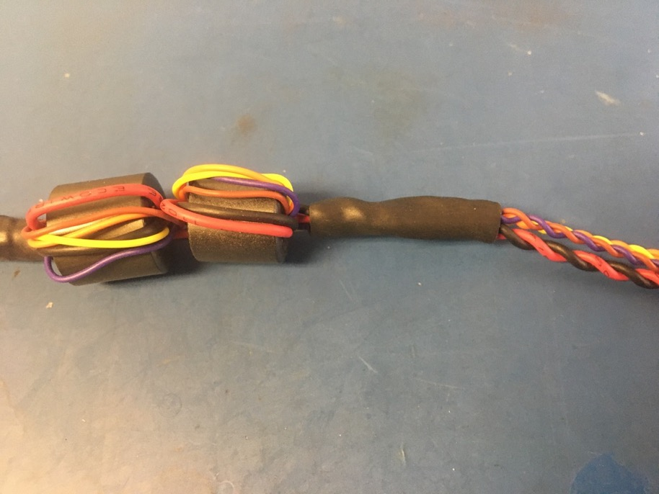
Place the 4.8mm piece of shrink tube onto the wire harness such that it abuts the magnets. Apply the heat gun. Place the 6.4mm piece of shrink tube onto the wire harness such that it layers over top the 4.8mm piece. Apply the heat gun.

Slide 27
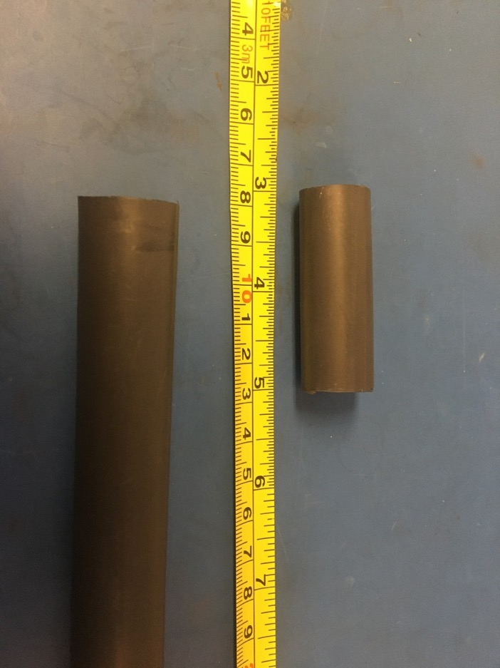
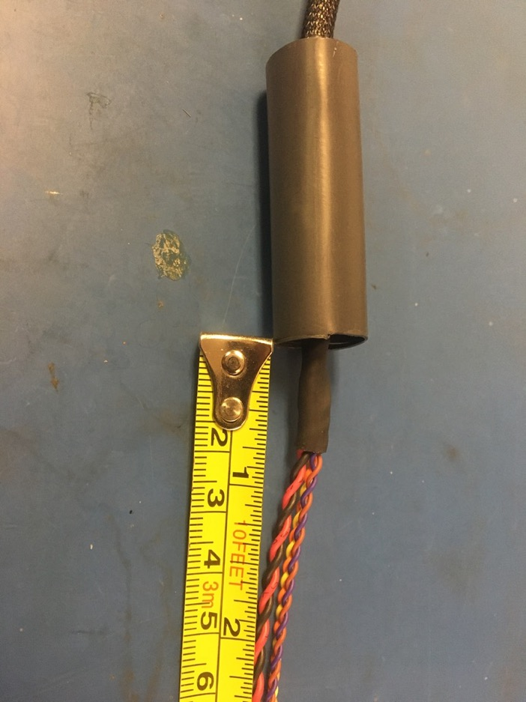
Measure out and cut one length of 16mm adhesive shrink tube that is 2in long. Place the piece of 16mm shrink tube over the magnets and far enough down so that .75 inches of the shrink tube applied on the previous slide is visible as shown on the right.

Slide 28
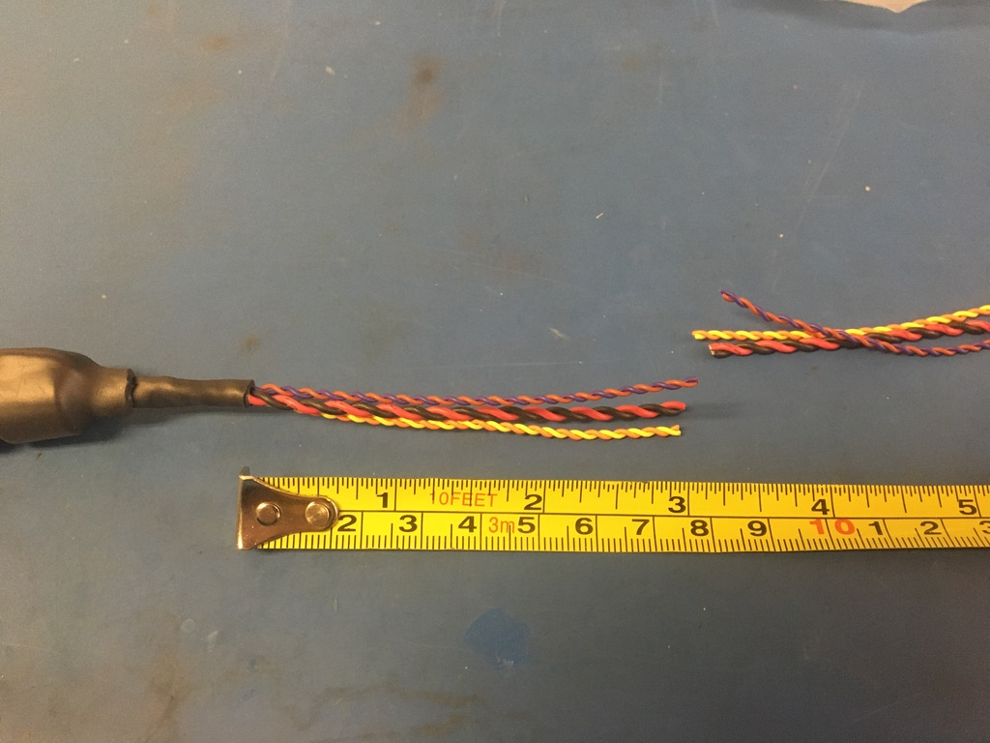
Measure and cut the twisted pairs on the magnet end of the harness so that they measure 3 inches.

Slide 29
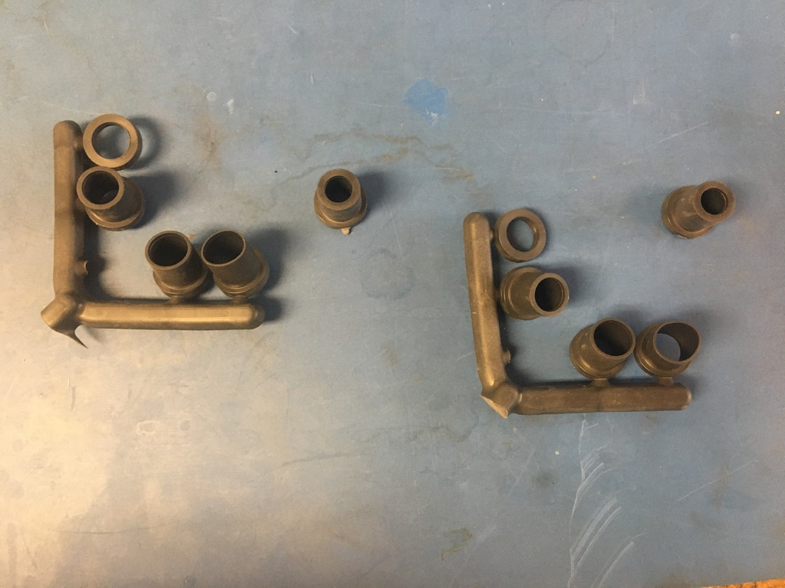
Select the D-sub shell stops. If using new D-sub shells, the smallest size is appropriate. However, if reusing old D-sub shells, use the smallest size available. Test the D-sub shell stops on each end of the wire harness. If the fit is loose, layer shrink tube until the fit is more snug.

Slide 30
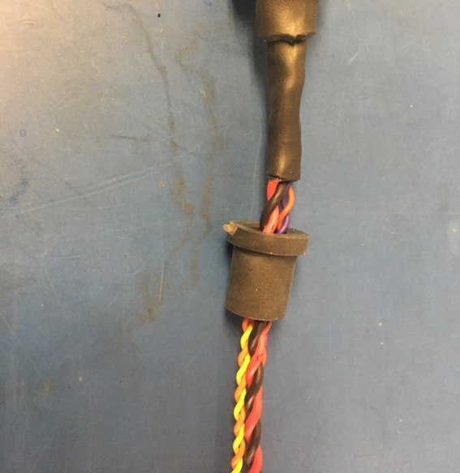
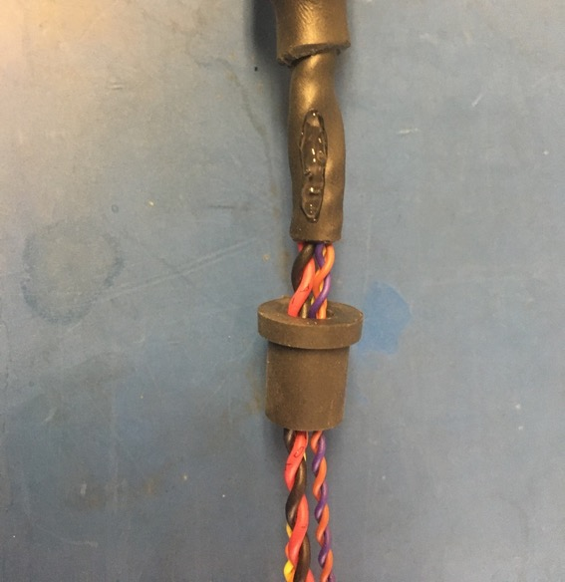
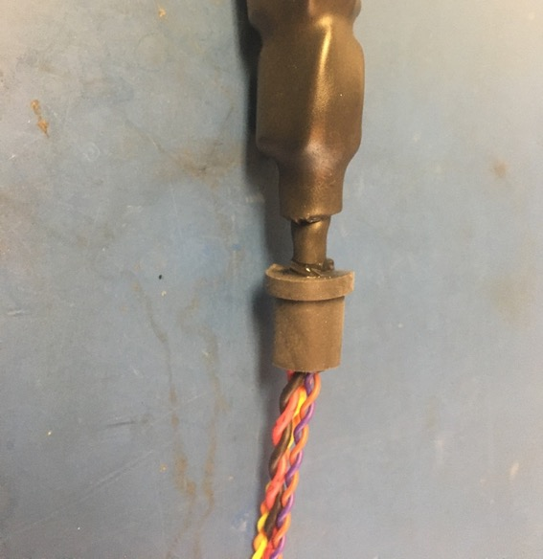
Once any additional shrink tube is added, thread the D-sub shell stop onto the magnet end of the harness and apply super glue to the end of the shrink tube as shown. Put the D-sub shell stop over the super glue and twist it around to spread the super glue inside the stop. The final position of the D-sub shell stop is as shown on the right: with the stop’s end flush with that of the shrink tube.

Slide 31
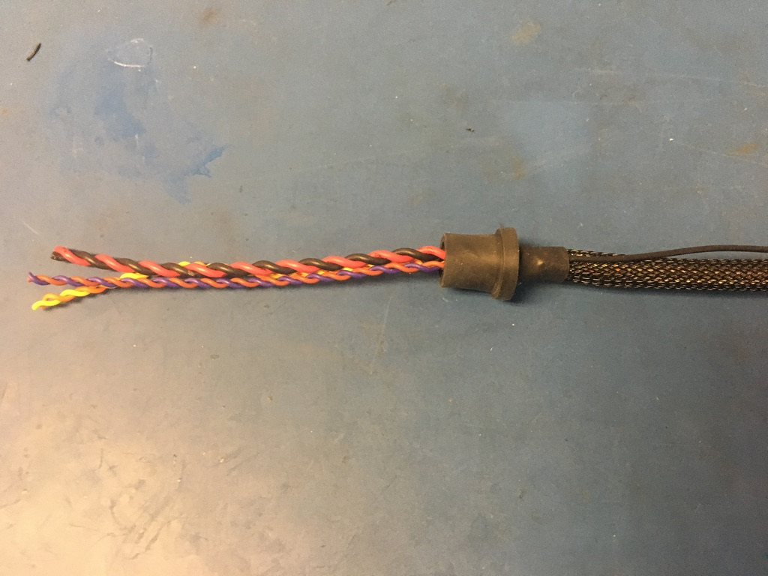
Repeat the process shown on the previous slide on the ground wire end. It’s recommended that the super glue be allowed to dry before continuing as it is easy to get on one’s hands.

Slide 32
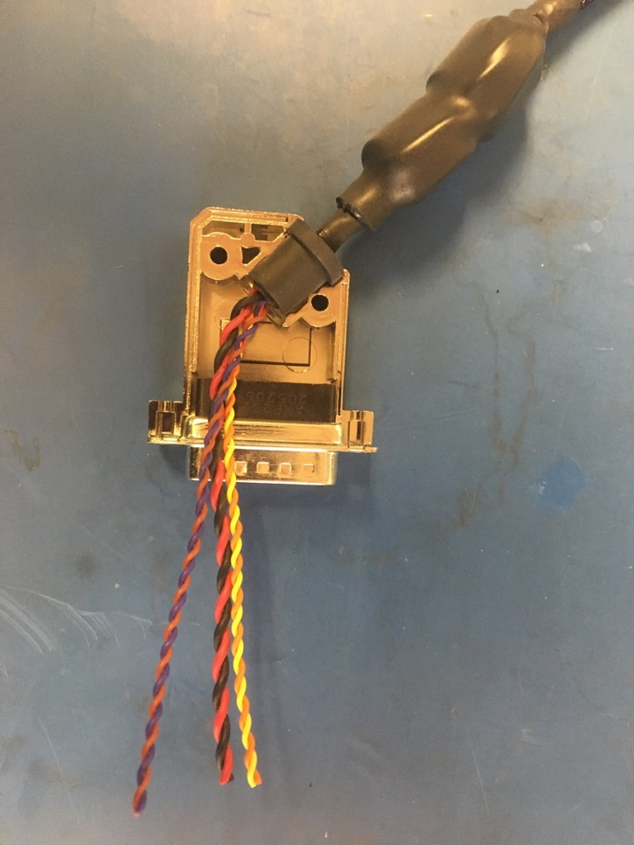
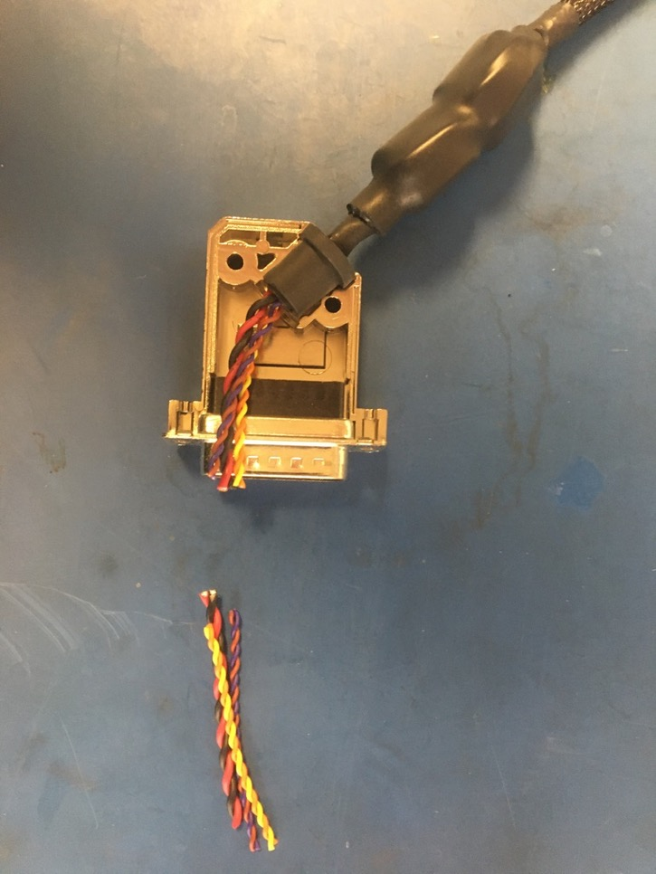
Taking the magnet end of the harness, place the D-sub shell stop into the bottom of the D-sub shell as shown. Put the 15 pin male D-sub connector into the bottom of the shell as well. Measure out and cut the twisted pairs so that they end at the mouth of the connector.

Slide 33
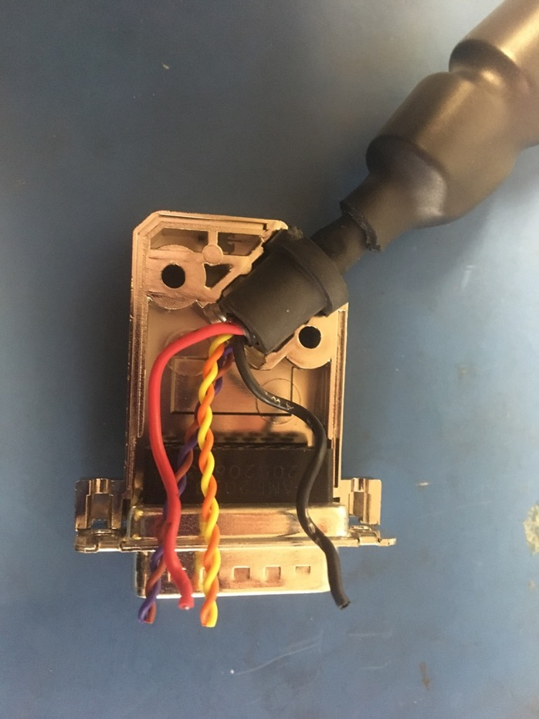
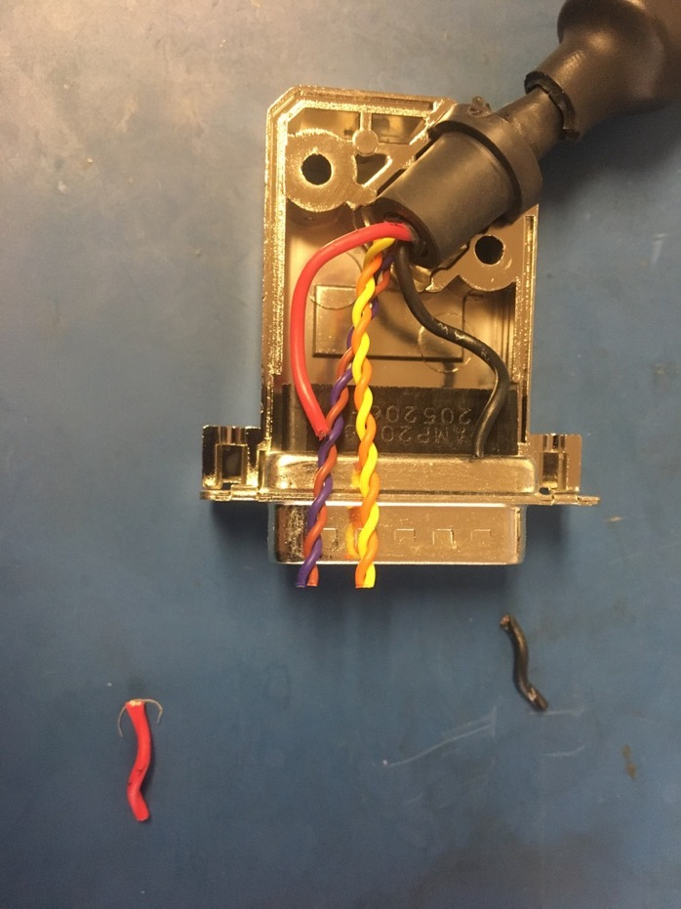
Untwist and straighten the red and black twisted pair. Position them as shown on the right and trim them so they end midway through the black part of the connector.

Slide 34
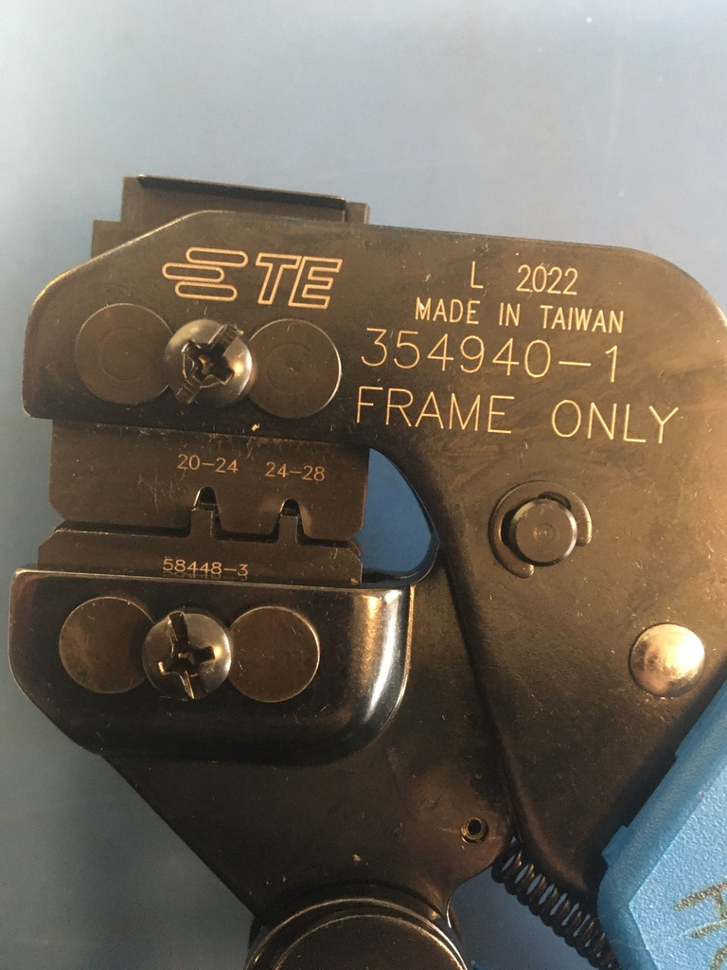
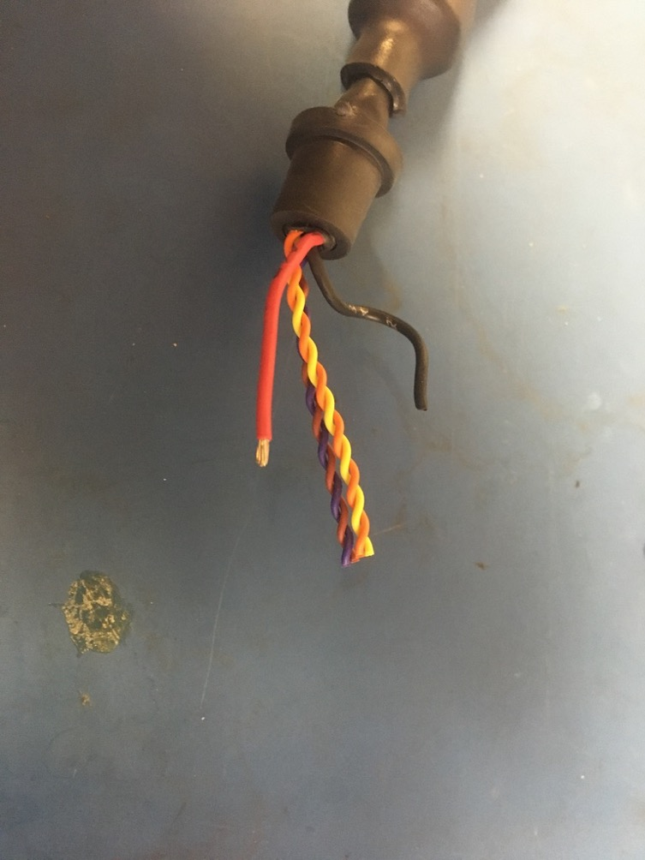
Strip about 2mm off the red wire. The D-sub crimper will be used for all the upcoming crimping though be sure to use the appropriate setting for the wire size. For the black and red wire, use the 20-24 awg setting.

Slide 35
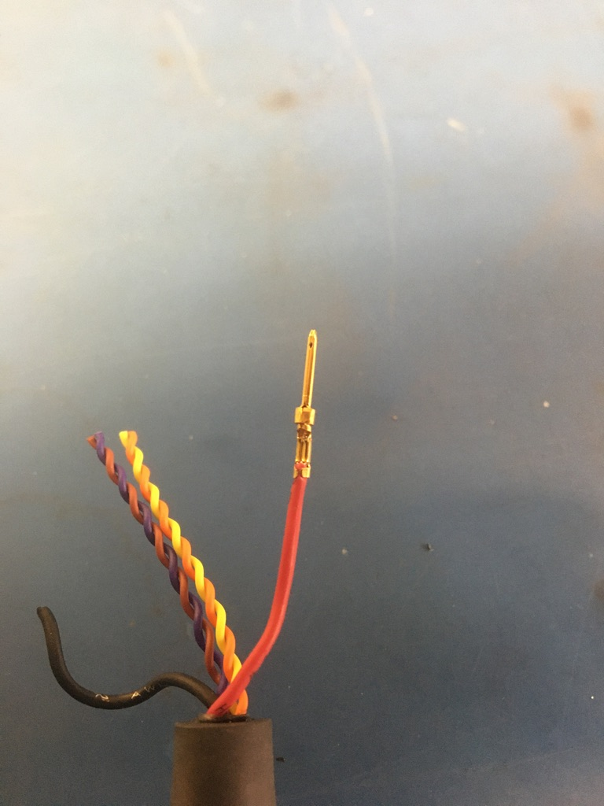
Exposed wire just visible
Crimp on a 20-24 D-sub pin onto the red wire. It should be crimped such that the isolation is held by the first grip but not the second. A bit of exposed wire should also be peaking out of the top of the second grip.
Isolation in first grip

Slide 36
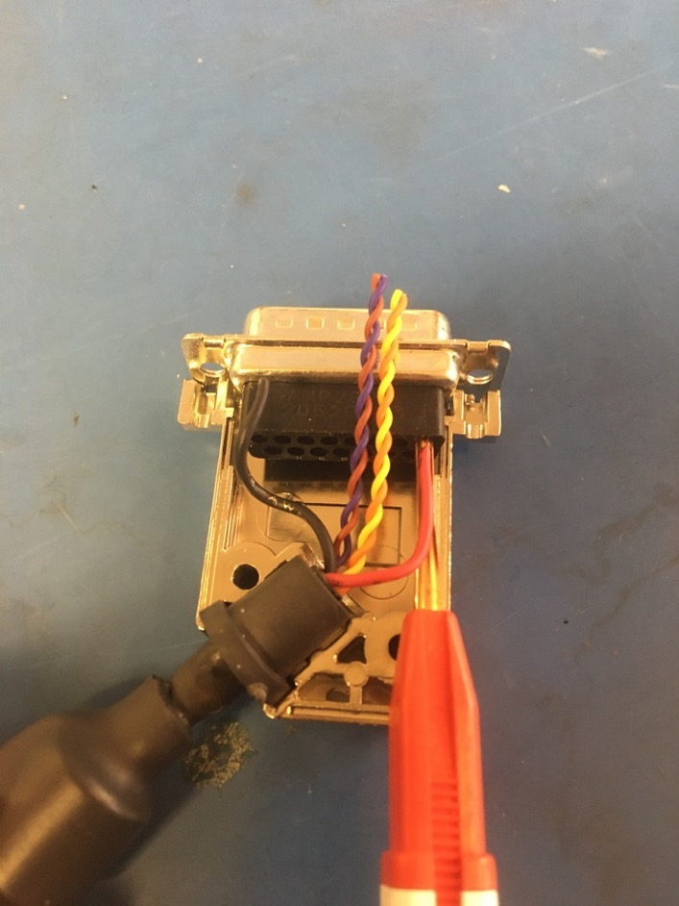

Insert the the red wire using the red end of the D-sub insertion/extraction tool. The pin should feel to click once inserted all the way. Please reference the accompanying pin out document to see where each wire should go.

Slide 37


Strip, crimp, and insert the black wire as previously exampled by the red wire.

Slide 38

Untwist and straighten the orange and yellow twisted pair.

Slide 39


Position the yellow and orange wires as shown in the photo on the left and trim them so they end midway through the black part of the connector. Strip, crimp and insert them. However, be sure to use to 24-28 awg pins and crimper setting this time.

Slide 40


Untwist and straighten the brown and violet twisted pair. Position them as shown in the photo on the right and trim them so they end midway through the black part of the connector.

Slide 41


Strip, crimp, and insert the brown and violet wires. Again, use the 24-28 awg pins and crimper setting. Place the top of the D-sub shell onto the bottom and put the connector screws and washers in.

Slide 42


Close the D-sub shell using the screws and nuts. Repeat slides 32-42 on the other end of the harness. The ends should be identical when complete.

Slide 43

Wire harness complete! The ground wire will be given a tip later.

